Slide 1
Malicious Software: Classification and Defence
Lecture 6

Slide 2
Contents:
1. Computer malware: removal and prevention
2. Antivirus software and its settings
3. Virus detection
4. Threat signature
5. Cyber attacks
6. Protection in databases and operating systems

Slide 3
Computer malware: removal and prevention
Families of malware include cryptominers, viruses, ransomware, worms and spyware. Its common objectives are information or identity theft, espionage and service disruption
Web and e-mail protocols lately were the most common initial attack vectors used to spread malware. However, using brute force techniques or exploiting system vulnerabilities, certain malware families were able to spread even further inside a network.

Slide 4
Types of malware
Ransomware: Locks your computer and demands payment to unlock
Spyware: Hides on your computer and discretely gathers information
Adware: Inserts ads and pop-ups onto your computer and web browsers
Trojan: Pretends to be another program to trick your operating system into installing it
Keylogger: Records and transmits everything you type onto your computer
Rootkit: Gives unauthorized users access to your computer and file system
Worm: Self-replicating program that infects and overwhelms a network or computer

Slide 5
Key findings (2019)
400.000 detections of pre-installed spyware and adware on mobile devices
13% increase in Windows malware detections at business endpoints globally
71% of organizations experienced malware activity that spread from one employee to another
46,5% of all malware in e-mail messages found in ‘.docx’ file type
50% increase in malware designed to steal personal data or stalkerware
67% of malware was delivered via encrypted HTTPS connections

Slide 6
Key findings (2019)
84% of cyberattacks rely on social engineering
67% of malware was delivered via encrypted HTTPS connections
230.000 new strains of malware every day
6 months in average is what it takes to detect a data breach
71% of organizations experienced malware activity that spread from one employee to another
52% increase in the number of web application attacks in 2019 compared with 2018
84% of observed vulnerabilities in web applications were security misconfigurations

Slide 7
Early detection and prevention
Ideally before the exploit phase happens
For incidents to be mitigated or dealt with by your team, they must first be detected, preferably as early in the attack phase as possible
Faster detection and prevention demands more intelligent, automatic and fluent sharing of threat intelligence
It is important to agree on standardizing threat information

Slide 8
Reactive security
Cybersecurity monitoring solutions: These solutions monitor a network looking for possible attacks as they happen.
Forensic analysis of security events: It is extremely useful to understand the methods used in an attack to help make cybersecurity policy decisions.
Anti-spam/ anti-malware solutions: Important, but can fail when new malware enters the landscape (e.g., fileless malware)
Firewalls: Important, but configuration issues can leave organizations vulnerable

Slide 9
Proactive security
Security awareness training: Preempting a social engineering or other phishing attacks by ensuring a user base knows how to spot the tell-tale signs and tricks of fraudsters.
Penetration testing: Using white-hat hackers to test IT systems to find exploitable vulnerabilities. Penetration tests will produce a report that can be used to close off potential exploits.
Proactive endpoint and network monitoring: New technologies, such as machine learning, are helping to make reactive measures more proactive by reducing false positives and negatives.
Threat hunting and threat intelligence: This is a set of complementary tasks performed by internal or external skilled staff. These tasks can be thought of as proactive digital forensics. An organization will engage an internal or external Red Team to hunt for vulnerabilities. These gaps in security can then be hardened against real attacks in a proactive way

Slide 10
Proactive cybersecurity defense also include
Disk encryption/protection. Encrypting hard drives enhances data security in the event that physical devices are lost, stolen or misplaced.
Security awareness training. Training internal employees keeps your team informed of the latest security best practices and evolving security threats to avoid.
Multi-factor authentication. Identifying and granting access only to the desired individuals and groups helps enforce data security, and a multi-step authentication process ensures proper access control.
Cybersecurity risk assessment. In the modern technological environment, businesses must have a comprehensive plan to manage all cybersecurity risks.
Vulnerability scanning. Vulnerability scanning software can automate the tasks of inspecting and identifying weaknesses and gaps in your existing cybersecurity defenses before an actual threat occurs.
Managed security operations center. A managed security operations center (SOC) centralizes the essential monitoring and incident response functions to a team of experts that can best protect your company’s data assets.

Slide 11
Malware intelligence
Services that provide information from static and dynamic analysis of malware samples and other related intelligence, going beyond a sandbox service.
This type of services usually offer access to a large data repository with the analysis results and extensive query capabilities to facilitate investigations, research and tracking of particular malware families.
One of the common methods for finding new malware samples relevant for the constituency is using YARA signatures that can be matched against newly observed samples or for historical data.

Slide 12
How to remove malware from PC
Step 1: Disconnect from the internet
Step 2: Enter safe mode
Step 3: Check your activity monitor for malicious applications
Step 4: Run a malware scanner
Step 5: Fix your web browser
Step 6: Clear your cache

Slide 13
2. Antivirus software and its settings
Antivirus databases contain what are called signatures, both in common usage and in writing.
A virus signature is a continuous sequence of bytes that is common for a certain malware sample. That means it’s contained within the malware or the infected file and not in unaffected files.
An antivirus database entry is just that: one entry. The technology behind it could be either a classic signature or something super-sophisticated, innovative, and targeting the most advanced malware

Slide 14
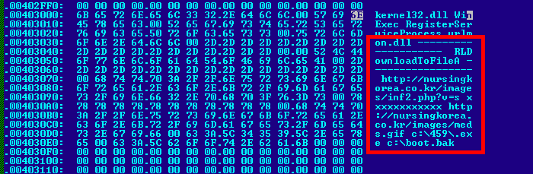
A characteristic sequence of bytes

Slide 15
Infectors
They are difficult to detect — at a glance, an infected file seems clean
Infectors require special treatment: almost all of them need specific detection and disinfection procedures

Slide 16
Disinfection
Scan and detect malware
Remove the malware
Special utilities do exist for certain types of malware

Slide 17
Security profiles
Security profiles help you define an allow but scan rule, which scans allowed applications for threats, such as viruses, malware, spyware, and DDOS attacks.
When traffic matches the allow rule defined in the security policy, the security profile(s) that are attached to the rule are applied for further content inspection rules such as antivirus checks and data filtering.
The firewall provides default security profiles that you can use out of the box to begin protecting your network from threats.
Security profiles include URL Filtering, Antivirus, Anti-Spyware, File Blocking,

Slide 18
Antivirus/Anti-malware
Real-time protection to block infection
Periodic scans for known and suspected threats
Automatic updating on a frequent (usually daily) basis
Renewable subscriptions to obtain updated threat signatures
Links to virus and threat encyclopedias
Inoculation of system files
Permissions-based access to the Internet
Scanning of downloaded files and sent/received emails

Slide 19
Recovery data/system
Recovery Console
Backup/Restore
Backup/Time Machine

Slide 20
Acceptable Use Policy
Keep antivirus, antispyware, and anti-malware programs updated.
Scan systems for viruses, spyware, and malware.
Understand major malware types and techniques.
Scan removable media drives (such as optical discs and USB drives) for viruses and malware.
Disable autorun (as described later in this chapter).
Configure scanning programs for scheduled operation.
Respond to notifications that viruses, spyware, or malware have been detected.
Quarantine suspect files.
Report suspect files to the help desk.
Remove malware.
Disable antivirus software when needed (such as during software installations) and know when to reenable antivirus software.
Avoid opening attachments from unknown senders.
Use anti-phishing features in web browsers and email clients.

Slide 21
Firewalls
Protection against unwanted Internet traffic
Network scanning
Sandboxing
Packet filtering (Internet protocol, User Datagram Protocol, Transmission Control Protocol)
Data traffic control (File Transfer Protocol )
Recording User Activity (Network Address Translation)

Slide 22
DNS Configuration
Domain Name Service (DNS) involves a database containing public IP addresses and their associated domain names.
The purpose of DNS is to translate domain names used in web page requests into IP addresses.
Domain name server functions are included in SOHO routers, and in larger networks, a separate domain name server can be used.
Domain name servers communicate with other, larger, domain name servers if the requested addresses are not in their databases.

Slide 23
3. Virus detection
Signature-Based Detection - detection tool that has its own set of known infection databases, but these always need to stay up to date on the user side to be effective.
Behavioral Detection is a method that is dynamic in the sense that it continually watches the actions of the installed programs for any odd behaviors.

Slide 24
Answer questions:
How to tell if your device has been infected with malware?
How to help protect your devices from malware? What actions to avoid?

Slide 25
4. Threat signature
A signature is defined as any detection method that relies on distinctive marks or characteristics being present in an exploits that contain distinctive marks, such as ego strings, fixed offsets, debugging information.
This type of detection is typically classified as day after detection
Anti-Virus companies utilize this type of technology for protecting their customers from virus outbreaks

Slide 26
Different types of threat signatures
For example, there types are designed to detect different types of threats as the firewall scans network traffic:
Antivirus signatures—Detect viruses and malware found in executables and file types.
Anti-spyware signatures—Detects command-and-control (C2) activity, where spyware on an infected client is collecting data without the user's consent and/or communicating with a remote attacker.
Vulnerability signatures—Detects system flaws that an attacker might otherwise attempt to exploit.

Slide 27
How to use threat signatures
A signature's severity indicates the risk of the detected event, and a signature's default action (for example, block or alert) is how you enforce matching traffic.
You must set up Antivirus, Anti-Spyware and Vulnerability protection to tell the firewall what action to take when it detects a threat, and you can easily use the default security profiles to start blocking threats.
For each signature type, category, and even specific signatures you can continue to modify or create new profiles to more granularly enforce potential threats.

Slide 28
Examples:
Downloader (Also known as droppers, stagers, or loaders) Detects programs that use an internet connection to connect to a remote server to download and execute malware on the compromised system. The most common use case is for a downloader to be deployed as the culmination of stage one of a cyber attack, where the downloader’s fetched payload execution is considered second stage. Shell scripts (Bash, PowerShell, etc.), trojans, and malicious lure documents (also known as maldocs) such as PDFs and Word files are common downloader types.

Slide 29
Examples:
Keylogger - detects programs that allow attackers to secretly track user activity, by logging keystrokes and capturing screenshots.
Keyloggers use various C2 methods to periodically sends logs and reports to a predefined e-mail address or a C2 server. Through keylogger surveillance, an attacker could retrieve credentials that would enable network access.
Phishing-kit - detects when a user attempts to connect to a phishing kit landing page (likely after receiving an email with a link to the malicious site). A phishing website tricks users into submitting credentials that an attacker can steal to gain access to the network.

Slide 30
Snort rules
Rules are a different methodology for performing detection, which bring the advantage of 0-day detection.
Unlike signatures, rules are based on detecting the actual vulnerability, not an exploit or a unique piece of data. Developing a rule requires an acute understanding of how the vulnerability actually works.

Slide 31
YARA rules
YARA rules are a way of identifying malware (or other files) by creating rules that look for certain characteristics.
It was developed with the idea to describe patterns that identify particular strains or entire families of malware.
YARA is a tool aimed at helping malware researchers to identify and classify malware samples. With YARA you can create descriptions of malware families based on textual or binary patterns. Each description, a.k.a rule, consists of a set of strings and a boolean expression which determine its logic.
The tool allows you to conduct signature-based detection of malware, something similar to what antivirus solutions can do for you.

Slide 32
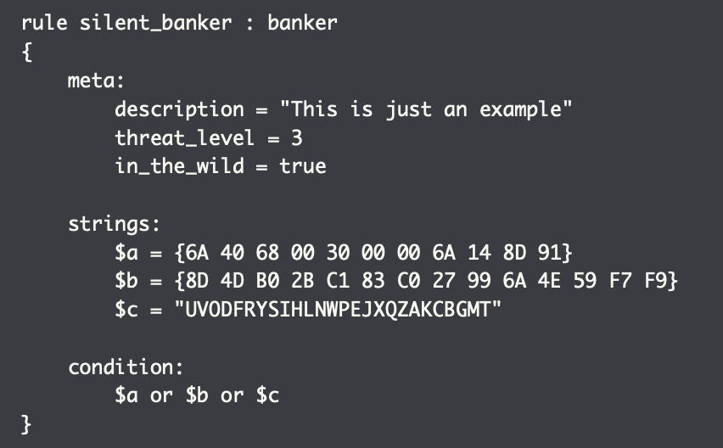
Example of YARA rule

Slide 33
YARA rules
The condition section is the only one that is required. This section specifies when the rule result is true for the object (file) that is under investigation.
The strings sections is where you can define the strings that will be looked for in the file.
Example:
rule vendor
{
strings:
$text_string1 = “Vendor name” wide
$text_string2 = “Alias name” wide
condition:
$text_string1 or $text_string2
}

Slide 34
There are several types of strings you can look for:
Hexadecimal, in combination with wild-cards, jumps, and alternatives.
Text strings, with modifiers: nocase, fullword, wide, and ascii.
Regular expressions, with the same modifiers as text strings.

Slide 35
Signature-Based Protection Is Not Enough
Attackers have developed countermeasures that they can use to bypass this method
With the use of various crypting services, packers and polymorphism, they can easily generate malware that’s different enough so that it no longer matches existing signatures
It then takes some time before the new flavor is picked up and a signature is shared

Slide 36
5. Cyber attacks
Cyber-space has no borders: There is much discussion in the media about who is behind this or that attack. Cyber attackers operate across borders and attackers can easily operate across continents.
Common attack methods: The attacks use a combination of two attack methods. 1) An innocent looking spear-phishing email, which to the victim seems like a genuine and harmless email. 2) A software vulnerability which is used to take control of the victim’s machine. Some investment is necessary to obtain information on latest vulnerabilities

Slide 37
Cyber attacks
Failing security measures: Many organisations have phishing filters and antivirus products. However, these measures do not seem to be always working when attacks are performed over a long period of time.
In cyber-space, prevention is key: If targets are unprotected, their weaknesses are going to be exploited by adversaries, regardless of their origin and motives.
Software vulnerabilities: There are trade-offs between software features and software security. The more features and interoperability features software has, the more difficult it is to ensure that the software is free of vulnerabilities.

Slide 38
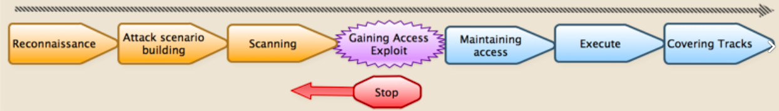
Phases of cyber attack

Slide 39
Cyber kill chain
The cyber kill chain is a series of steps that trace stages of a cyberattack from the early reconnaissance stages to the exfiltration of data.
A comprehensive understanding of cyber-attacks and the Cyber kill chain (CKC) requires awareness of the vulnerability lifecycle including development of vulnerabilities into exploits.
The CKC also provides aspects of threat intelligence by assigning some attacker behaviours to specific events and uses model descriptions to comprehend those behaviours.
By modelling threats, the CKC helps determine severity of the attack and explains how they are enacted.

Slide 40
Cyber kill chain
Reconnaissance
Weaponization
Delivery
Exploitation
Installation
Command and control
Actions on objectives

Slide 41
Trends
Malware-as-a-service (MaaS) refers to a specific malware sold in underground forums which provides customers (cyber criminals) with the tools and infrastructure needed for targeted attacks.
Fileless malware does not contain an executable file and can evade common security filters and whitelisting techniques. Instead of an executable file, this type of malware requires the attacker to inject malicious code into already installed and trusted software, either remotely or by actively downloading document files containing malicious macros
More malware going fully mobile; fraudulent apps, SIMJacking and operating systems exploits make these devices the weakest link and therefore, extremely vulnerable to attacks
Attackers are using new file types such as disc image files (ISO and IMG) for spreading malware. DOC, PDF, ZIP and XLS files are still the most commonly used attachment type for spreading malware but other types are getting popular.

Slide 42
Attack vectors
Malicious actors will explore the potential of digital platforms to support targeted attacks (e.g. social media, gaming, messaging, streaming, etc.).
With more automation and less human intervention, business processes can be maliciously altered to generate profit for an attacker.
E-mail is no longer the prime and only tool and top attack vector for phishing. Malicious actors are now using other platforms to communicate and attract victims to open compromised web pages. A new trend is emerging with the use of SMS, WhatsApp, SnapChat and social media messengers.

Slide 43
Most targeted sectors
Services such as e-mail, social and collaborative platforms and cloud providers were under attack during 2019.
The financial returns from ransoms paid makes the public sector one of the most attractive targets for ransomware attacks.
Financial and Healthcare

Slide 44
Most desired assets by cyber criminals
Industrial property and trade secrets
State/military classified information
Server infrastructure
Authentication data
Financial data

Slide 45
6. Protection in databases and operating systems

Slide 46
Database security
Connecting to the Database
Disabling network (TCP) access and requiring all access is over a local socket file or named pipe.
Configuring the database to only bind on localhost.
Restricting access to the network port to specific hosts with firewall rules.
Placing the database server in a separate DMZ isolated from the application server.

Slide 47
Transport Layer Protection
Most databases will allow unencrypted network connections in their default configurations. Although some will encrypt the initial authentication (such as Microsoft SQL Server), the rest of the traffic will be unencrypted. The following steps should be taken to prevent unencrypted traffic:
Configure the database to only allow encrypted connections.
Install a trusted digital certificate on the server.
Configure the client application to connect using TLSv1.2+ with modern ciphers (e.g, AES-GCM or ChaCha20).
Configure the client application to verify that the digital certificate is correct.

Slide 48
Authentication
The database should be configured to always require authentication, including connections from the local server. Database accounts should be:
Protected with strong and unique passwords.
Used by a single application or service.
Configured with the minimum permissions.

Slide 49
Storing Database Credentials
Is outside of the webroot.
Has appropriate permissions so that it can only be read by the required user(s).
Is not checked into source code repositories.

Slide 50
Permissions
Do not use the built-in root, sa or SYS accounts.
Do not grant the account administrative rights over the database instance.
Only allow the account to connect from whitelisted hosts.
This would often be localhost or the address of the application server.
Only grant the account access to the specific databases it needs.
Development, UAT and Production environments should all use separate databases and accounts.
Only grant the required permissions on the databases.
Most applications would only need SELECT, UPDATE and DELETE permissions.
The account should not be the owner of the database as this can lead to privilege escalation vulnerabilities.
Avoid using database links or linked servers.
Where they are required, use an account that has been granted access to only the minimum databases, tables, and system privileges required.

Slide 51
Database Configuration and Hardening
Install any required security updates and patches.
Configure the database services to run under a low privileged user account.
Remove any default accounts and databases.
Store transaction logs on a separate disk to the main database files.
Configure a regular backup of the database.
Ensure that the backups are protected with appropriate permissions, and ideally encrypted.

Slide 52
Microsoft SQL Server
Disable xp_cmdshell, xp_dirtree and other stored procedures that are not required.
Disable Common Language Runtime (CLR) execution.
Disable the SQL Browser service.
Disable Mixed Mode Authentication unless it is required.
Ensure that the sample Northwind and AdventureWorks databases have been removed.
See Microsoft's articles on securing SQL Server.

Slide 53
References:
YARA's documentation, https://yara.readthedocs.io/en/stable/
Basic Snort Rules Syntax and Usage, https://resources.infosecinstitute.com/topic/snort-rules-workshop-part-one/
Malware, https://www.malwarebytes.com/malware/

